Slide 1
Real-Time Wave Energy Converter Control Using Instantaneous Frequency
Inyong Kim
2025.02.21
Notes:
Real-Time Wave Energy Converter Control Using Instantaneous Frequency

Slide 2
Research Objectives
Testing the field sea conditions on WEC model using instantaneous frequency information
Real-time PTO control using impedance matching
Validating that the new methods perform better than baseline approach

Slide 3
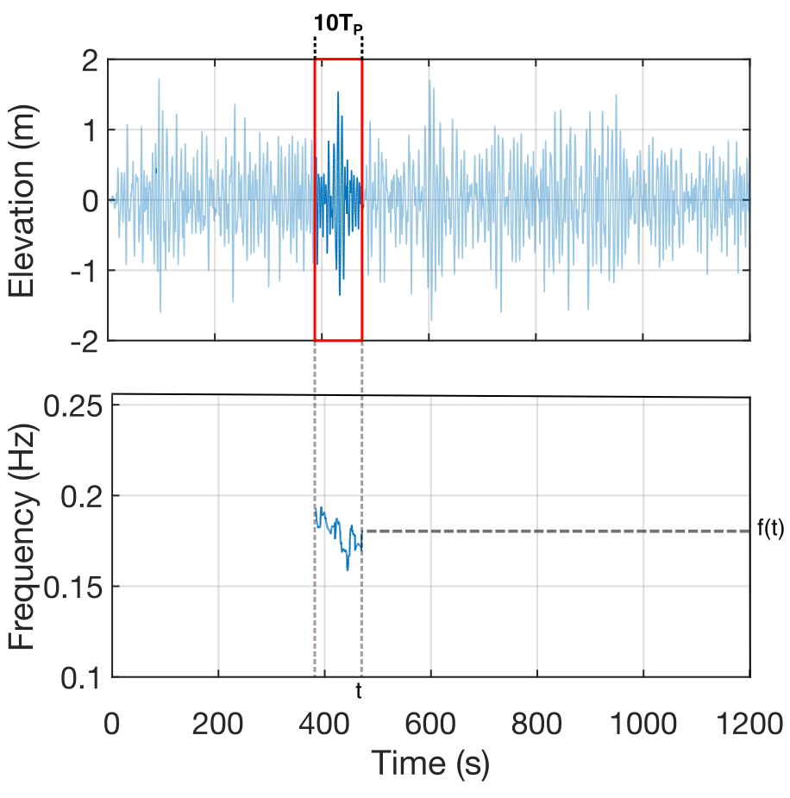
RT-Hilbert Transform Approach
Short Time Hilbert Transform
Moving Median Filter
An example of real-time instantaneous frequency calculation using Short-time Hilbert transform
Notes:
Real-time I.F has been calculated by Hilbert transform and moving median filter in a limited time window such that 10 times the mode period of waves.

Slide 4
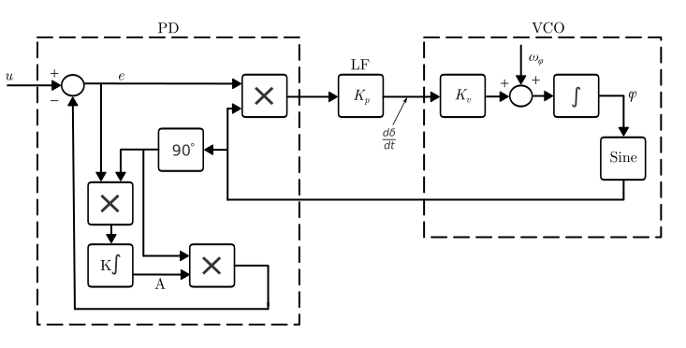
Phase-Lock Loop Approach
Block diagram of the Phase-Locked Loop (PLL) used in this study. The block diagram
consists of three main components: the Phase Detector (PD), which extracts the phase difference
between the input wave signal and the internally generated VCO output; the Loop Filter (LF), which
smooths the phase error signal and determines the system’s bandwidth and transient response;
and the Voltage-Controlled Oscillator (VCO), which dynamically adjusts its frequency to match the
estimated instantaneous frequency of the incoming wave. The control gains within the loop filter are
tuned for optimal tracking performance in varying wave conditions.

Slide 5
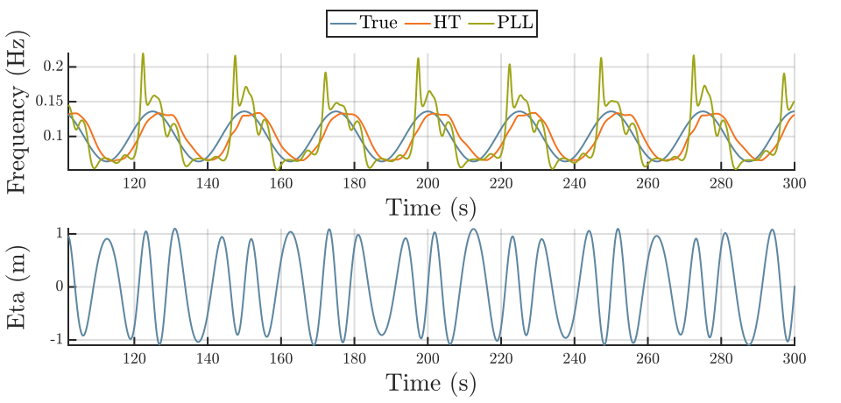
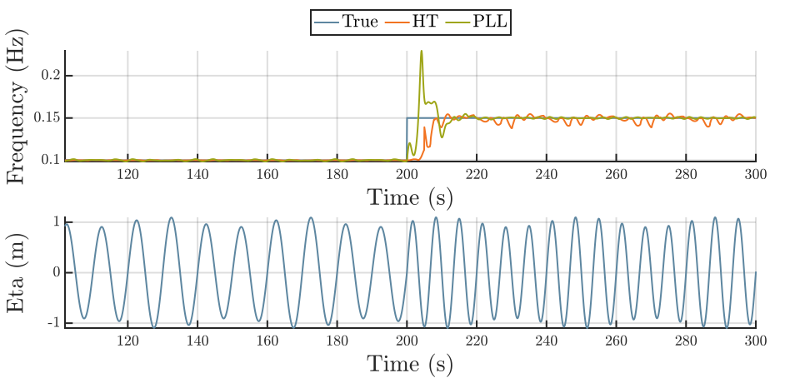
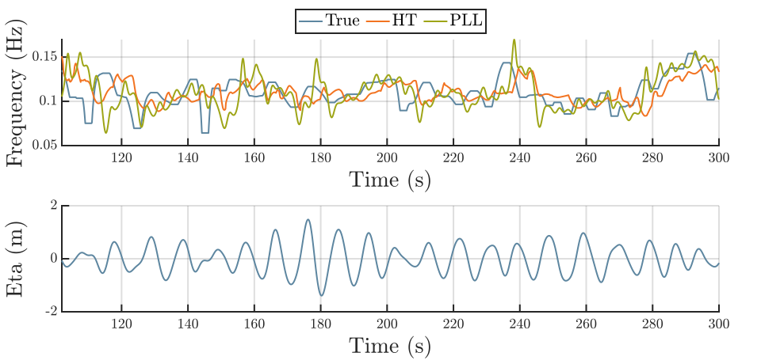
Estimation comparision

Slide 6
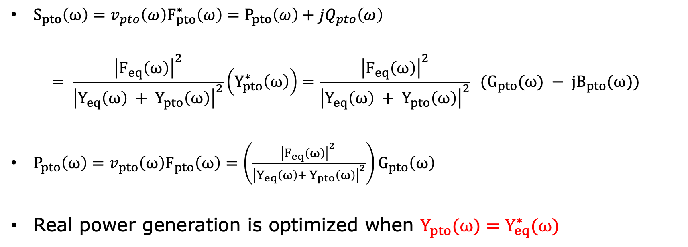
Impedance Matching for Maximum Power Transfer
$S_{pto}\left(ω\right)=v_{pto}\left(ω\right)F_{pto}^{∗}\left(ω\right)=P_{pto}\left(ω\right)+jQ_{pto}\left(ω\right)$
$$= \frac{{\left|F_{eq}\left(ω\right)\right|}^{2}}{{\left|Y_{eq}\left(ω\right) + Y_{pto}\left(ω\right)\right|}^{2}}\left(Y_{pto}^{∗}\left(ω\right)\right)=\frac{{\left|F_{eq}\left(ω\right)\right|}^{2}}{{\left|Y_{eq}\left(ω\right) + Y_{pto}\left(ω\right)\right|}^{2}} (G_{pto}(ω) − jB_{pto}(ω))$$
$P_{pto}\left(ω\right)=v_{pto}\left(ω\right)F_{pto}\left(ω\right)=\left(\frac{{\left|F_{eq}\left(ω\right)\right|}^{2} }{{\left|Y_{eq}\left(ω\right)+ Y_{pto}\left(ω\right)\right|}^{2}}\right)G_{pto}\left(ω\right)$
Real power generation is optimized when $Y_{pto}(ω)=Y_{eq}^{∗}(ω)$
Notes:
"The apparent power generated by the Power Take-Off (PTO) system can be expressed in the first equation. In the second equation, we can see the true power of the PTO.
By adjusting the control parameter to match the conjugate of the equivalent hydrodynamic coefficient of RM3, we can achieve optimal power generation."

Slide 7
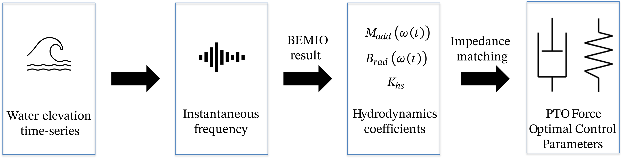
PTO Control via I.F.
Workflow for determining the optimal PTO control parameters using instantaneous frequency information.

Slide 8
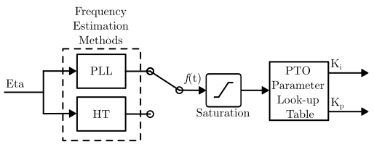
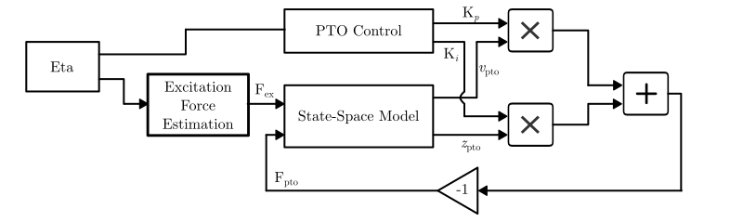
WEC Model

Slide 9
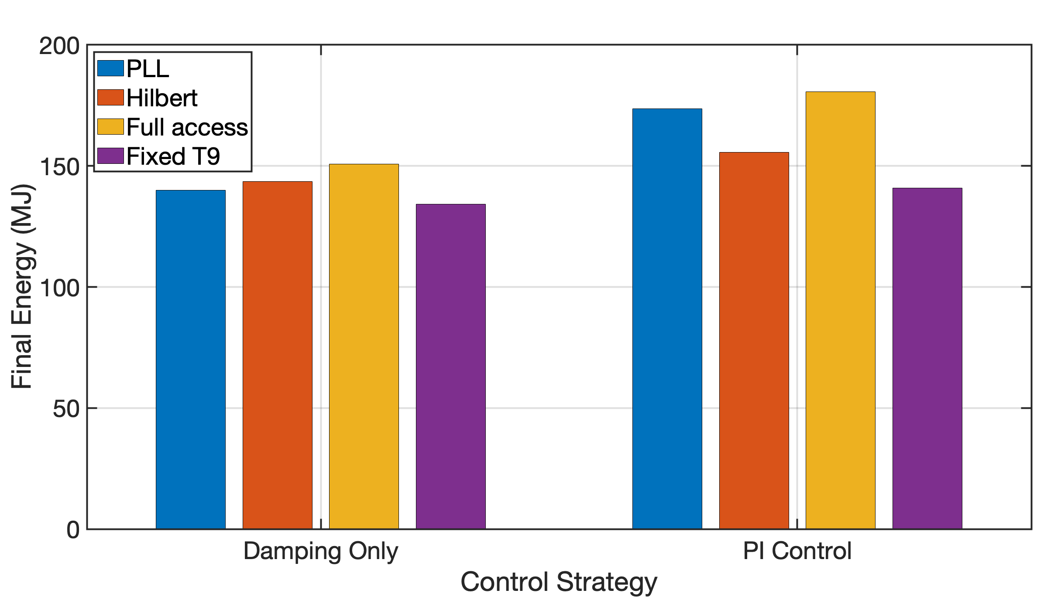
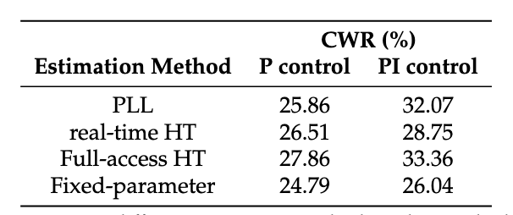
Results
The HT achieves a 10.4% improvement
PLL estimation yields a 23.2% improvement
relative to the Fixed-Parameter Control baseline.

Slide 10
Conclusion
Instantaeous frequency information of incoming wave signal is useful for tuning the PTO control parameters.
The wave prediction will help improving performance of the PTO.

